Slide 1

AliAlive
(阿里活著)
Bringing wholesalers to you.
Rhea Bhalla, Surya Tahliani, Taylor Ford, Jimmy Wu

Slide 2
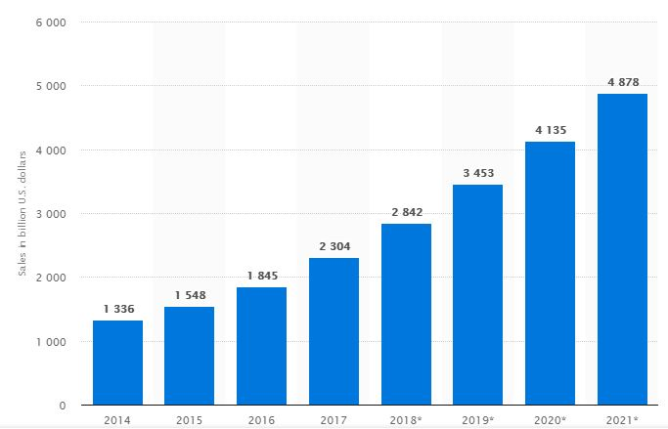
Industry Overview - e-Commerce
The e-Commerce industry accounted for $2.3 trillion USD in 2017 worldwide
The industry is comprised of online retail, digital advertising, and business-to-business enterprise/networking services
More than 40% of the world’s e-Commerce takes place in China. Industry leaders include Amazon, Wal-Mart, Alibaba, eBay, and Zalando
In essence, a booming industry with Alibaba playing a key role in its massive growth
Retail e-commerce sales worldwide from 2014 to 2021 (in billion U.S. dollars)
Worldwide e-Ecommerce Sales
Source: Value Line

Slide 3
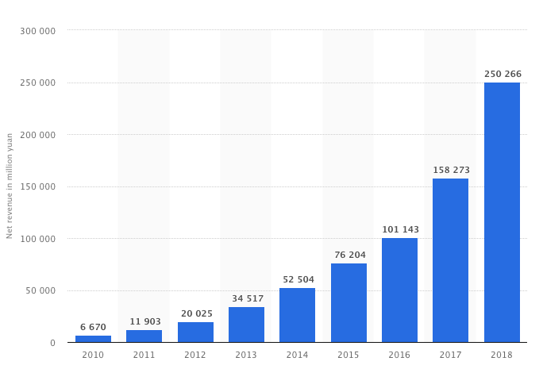
Company Overview - Alibaba
Founded by Jack Ma in 1999, unique business model - Alibaba is divided into three core businesses:
Alibaba - B2B trading, connects manufacturers to retailers
Taobao - B2C shopping website
Tmall - B2C branded shopping targeted at middle class
Alibaba accounts for 58% of China’s online retail sales
2017 transactions totalled $248 billion - significantly more than that of eBay and Amazon.com combined
Annual Revenue of Alibaba Group (2010 to 2018 (in million yuan)
Annual revenue of Alibaba Group from 2010 to 2018. In the fiscal year ending March 2018, Alibaba recorded consolidated revenues of 250.3 billion yuan. This translates to approximately 39.9 billion U.S. dollars.
Notes:
Baba: Merchants can list their products for free on Alibaba.com, but also have the option to pay for a range of benefits such as greater exposure on the site and unlimited product listings.

Slide 4
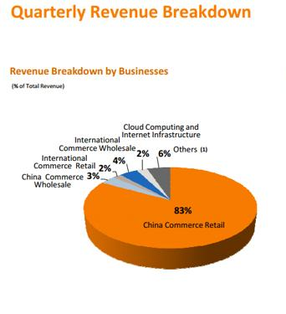
Company Overview - Alibaba
Unlike Amazon, Alibaba Group holds no inventory and owns no warehouses
Rather, Alibaba has created software platforms that facilitate the exchange of goods and services
Alibaba's revenues are less than Amazon's, it has higher operating margins and profit margins
Alibaba owns nine other companies and operates in a variety of different industries and verticals
Also created an ecosystem of payments, cloud computing, logistics, and data management companies to compliment their ecommerce business
Single’s Day generated $30.8 billion in sales in one day
Notes:
Baba: Merchants can list their products for free on Alibaba.com, but also have the option to pay for a range of benefits such as greater exposure on the site and unlimited product listings.

Slide 5





SWOT Analysis
Large Scale of Operations
Visionary Leader (Qualitative)
Large Market Share
Too many sellers/too many options
Very high discounts
Little to no customer service
Weak product description
Experience in China
Areas to refine/Product management
Aggregator based model
Opportunity for physical & creative customer interaction
Stability of the economy
Dropping profitability
Rising Competition

Slide 6




Proposed Solution
Introducing AliAlive, by Alibaba
AliAlive: a platform where live streaming features are offered. Businesses can personally interact with their customers in a Q&A live video environment, as well as observe the process of creation, customization, and environment in which the product comes from through layering elements of VR and AR.
Utilize strengths, Combat our weaknesses, maximize our opportunity, dodge threats

Slide 7
Components of AliAlive
Live Streams
Virtual Reality
AliAlive
Customer Experience
Augmented Reality

Slide 8
Steps to Create AliAlive
Step One
Step Two
Step Three
Step Four
Introduce wholesalers to new software, ensure legality through proper certification (Internet Culture Business Permit)
Connect wholesalers and retailers through the live streaming platform with VR/AR elements, rank sellers/retailers and schedule advertising
Regulate trade flow by incentivizing good conduct/selling practices through ranking priority
IE: top companies with high reviews AND stellar AliAlive conduct featured on homepage on Single’s Day
Result:
Increase overall customer service and experience for wholesalers and retailers, generate ad revenue for sellers
Notes:
SURYA: for step 3, can we potentially talk about better products

Slide 9
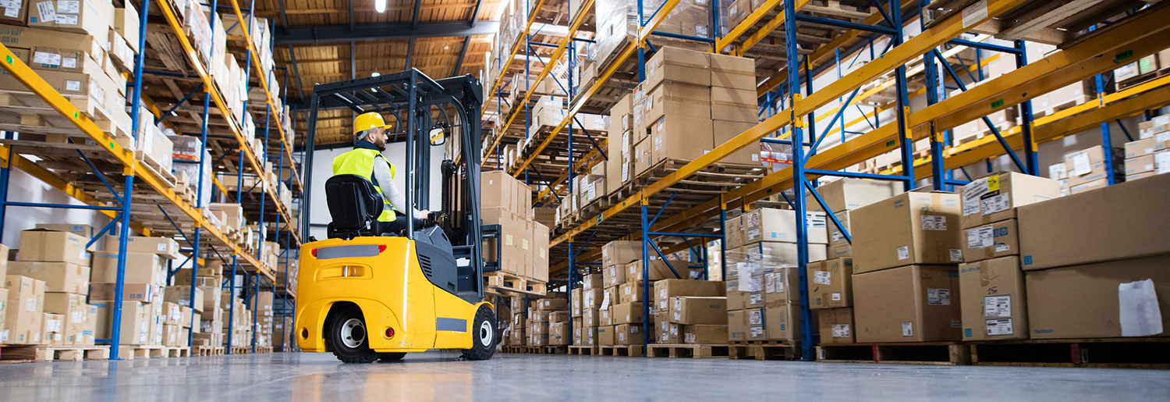
WHOLESALERS → RETAILERS
Wholesalers get to use this feature for free. This creates a more personalized experience between the buyer and seller. It will implement a customer service feature that will emphasize the availability of premium and luxury goods across all Alibaba retail services.
WHO
WHO

Slide 10
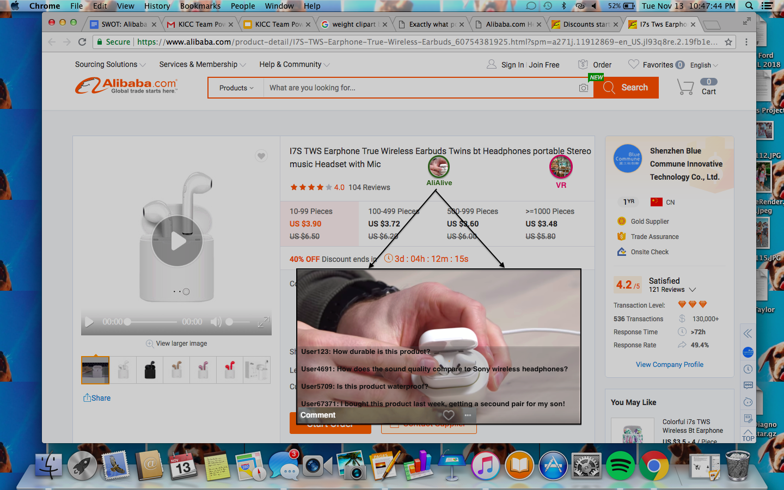
WHAT

Slide 11
“Just as China sets the world pace in e-commerce, it's doing the same for live streaming. More than 100 million viewers watch a live online video event every month, according to digital brand researcher L2. As an e-commerce tool, the typical live streaming format involves a celebrity demonstrating a product and answering questions from a digital audience. It takes place in real-time and usually on a smartphone, which accounts for some 95% of e-commerce activity in China. Live streaming has indeed become a powerful tool, with Deloitte estimating that China's live streaming revenue will hit $4.4 billion this year, up 32% from 2017.” -Forbes.com

Slide 12
Technology Behind AliAlive
Virtual Reality
Augmented Reality
Alibaba will offer a virtual reality platform to its wholesalers sitewide.
This computer generated simulation will create a three-dimensional image of the warehouse of the wholesaler.
The buyers will be able to interact with the items they would like to purchase in what seems to be a real and physical way.
The Alibaba app will launch a new augmented reality sector through AliAlive.
This will allow consumers to try on their products before they reach their doorstep.
This augmented reality feature will allow buyers to tailor their products to their liking.

Slide 13
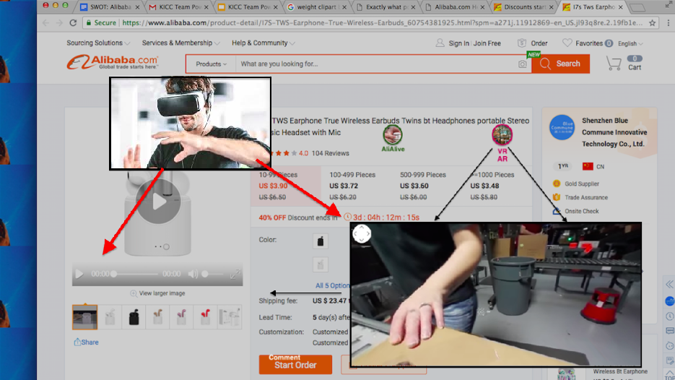

WHAT

Slide 14
“The VR/AR push in China has top-level backing. President Xi Jinping speaks of its importance, and the central government’s current VR/AR push in China has top-level backing. President Xi Jinping speaks of its importance, and the central government’s current (2016-2020) Five Year Plan includes virtual reality as a focus area for economic growth. Plenty of money is behind the push. Newer Chinese VR companies received a total of US $543 million in venture capital during 2015-16.”-Forbes.com

Slide 15
Will AliAlive Benefit….
WHY
Alibaba
The Wholesalers
Viewers will watch an ad before continuing to their livestream experience.
Advertisers will be able to request a certain amount of ads to be shown each month. They can choose from skippable ads, which cost less, or non-skippable, which are more costly.
This will increase the revenue of Alibaba by earning income through advertisement.
Alibaba will also establish good reputability by confirming product quality through a personable outlet with the their sellers.
Customers will be able to gain a deeper understanding of the product by seeing it in use by a real human, rather than a chatbot that competing companies offer.
Alibaba will not have to hire additional employees to complete this service, because the labor will be done by the wholesaler themselves.
Wholesalers will be able to separate their product apart from the thousands of products offered through Alibaba and their sister websites.
This service will eliminate the second guessing that buyers have while on the site, because they will be able to see the product they would like to purchase in action.
AliAlive will create a platform for “premium wholesalers” to showcase their items. This would allow them to gain exposure they otherwise would not have had.
AliAlive is a platforming network on a heavily populated site. This allows wholesalers to convey their personality to. This further refines their brand and gives them the opportunity to self-promote positive publicity.
Chinese TV is entirely state owned, so commercials are scripted and airbrushed. Live streaming generates authentic reactions and a feeling of authenticity.

Slide 16
Numbers
Live Streaming
Live streaming is going to be a $70.5 billion industry by 2021.
Live streaming is becoming a leading sales platform in China - currently more than 200 live streaming sites with over 200 million users, Credit Suisse predicts the China live streaming market will see US$5 billion in revenue this year
AR
AR market will reach $83 billion by 2021, driven primarily by AR on mobile devices
Lacoste introduced an AR app to allow users to digitally try on shoes and attracted 30,000 regular users.
WSJ: Businesses are demanding 360-panoramic VR technology more than consumers
Sources: huxiu.com, WSJ, HubSpot, MarTech

Slide 17
© 2018 KPMG International Cooperative ("KPMG International"), a Swiss entity. Member firms of the KPMG network of independent firms are affiliated with KPMG International. KPMG International provides no client services. No member firm has any authority to obligate or bind KPMG International or any other member firm vis-a-vis their parties, nor does KPMG International have any such authority to obligate or bind any member firm. All rights reserved.
The information contained herein is of a general nature and is not intended to address the circumstances of any particular individual or entity. Although we endeavour to provide accurate and timely information, there can be no guarantee that such information is accurate as of the date it is received or that it will continue to be accurate in the future. No one should act on such information without appropriate professional advice after a thorough examination of the particular situation.

